Slide 1
Application Development with HTML5
Clark Sell
Microsoft
@csell5
www.csell.net

Slide 2


About Me
www.ClarkSell.info
@csell5
csell@microsoft.com
Husband and father
Web Evangelist, Microsoft
Web developer for life
Greater Chicago Area
Notes:
First, a little about myself.
Image is owned by me.

Slide 3
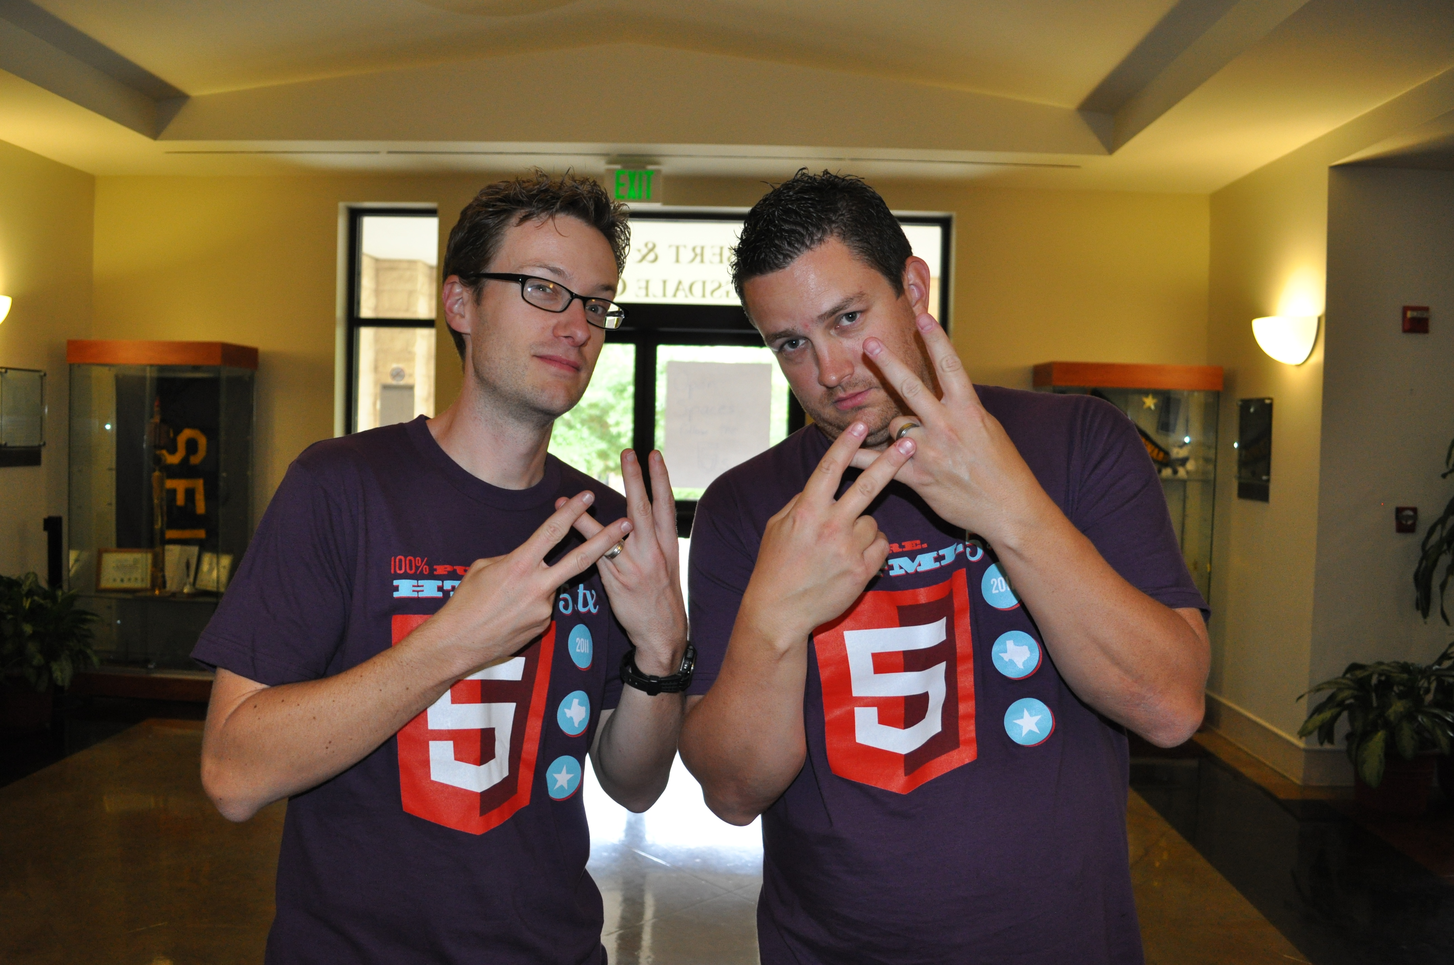

What is “HTML5”?
The direction the web is going?
What’s new and interesting on the web?
Just some new markup?
All or none of these?
Notes:
Now, let’s start by asking the question, “what is HTML5?”
To some, HTML5 is where the web is headed.
To others, it means everything new and interesting on the web.
To some, it just means a handful of changes to markup that we already write.
Today, what I’m going to talk about is what I think HTML5 means…
And of course like any awesome geekery, we also have an official gang sign. But before you go flashing it, make sure you study it and have your webcam working.
Image from http://www.flickr.com/photos/studholme/4800906130/ (used with permission from boblet – License: Creative Commons Attribution)

Slide 4

“Upgrade the site to HTML5? by close of business TOMORROW?”
Notes:
But what’s even more important, is what does HTML5 mean to you.
If you’re like me, you’re starting to become a little more than overwhelmed with the rate of change and the sheer number of things you want to keep up with.
Surely, I’m not just describing myself, am I? Show of hands, how many others feel that way?
It’s easy to become tired at the pace of change, so the last thing I want to do is overwhelm you. Instead, I am here to equip you with tools and techniques you can use today when you leave the room.
Image from http://www.flickr.com/photos/mindaugasdanys/3766009204/ (Used with permission from mdanys – License: Creative Commons Attribution)

Slide 5
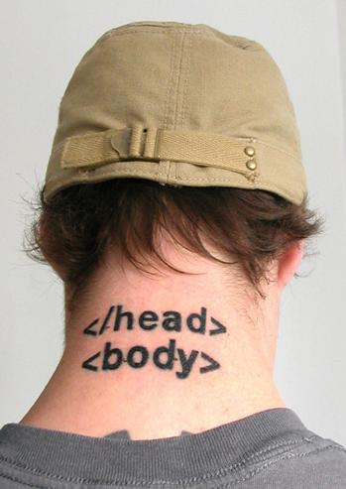
What does “HTML5” Mean to YOU?*
How you evaluate HTML5 technologies
What you choose to adopt
How you implement them
AND how to avoid leaving older browsers behind
*Tattoos optional
Notes:
I can stand up here and tell you what I think html5 means but I can’t honestly tell you what it should mean to you. So when I say, “What HTML5 means to you,” I mean that
I want you to leave today with a definition of HTML5 that you can rely on
I want you to leave with a process by which you can evaluate and choose HTML5 technologies
Lastly, I want you to understand how you can use these technologies today while ensuring that users visiting with older browsers still receive a great experience.
You’re already here because of some interest in HTML5. HTML5 is the future and it’s here in a big way.
Image from http://www.flickr.com/photos/daniello/422213306/ (used with permission from webmove – License: Creative Commons Attribution)

Slide 6
Agenda
Defining HTML5
The five most important words about HTML5
HTML5: mix tape edition
Some thoughts on development tools
Stuff you should learn
Notes:
So with all of that said, here’s our agenda for the day.
We’ll start by defining the HTML5 standard.
Then, I’ll give you the five most important words you need to know about HTML5.
After that, I’ll walk through a number of site ready HTML5 technologies, showing you how to adopt each while still supporting older browsers.
I’ll also talk about the Microsoft’s process for adopting HTML5 technologies in the browser. Where you can go to see what’s upcoming, experiment with newer specs and give us feedback.
Finally, I talk briefly about updates to Microsoft’s developer stack and provide some resources to learn more about HTML5, CSS and JavaScript.

Slide 7
Defining HTML5*
*Air Quotes Required
Notes:
As I’ve eluded, HTML5 can be a confusing term. Partly because its meaning is a moving target.
Some narrowly define it to mean just some new elements in markup.
Others define it as whatever new technology they want to implement in their site.
Other still use the term to mean everything new and interesting on the web, including older technologies that are not even part of the official spec like Geolocation and SVG.
Regardless, let’s arm ourselves with a more reasonable definition of HTML5 that we can use today in conversations with fellow developers, co-workers and customers.

Slide 8
“ ”
+
+
=
JavaScript APIs
HTML
CSS 3
Geolocation
Web Storage
Web Sockets
FileAPI
Media Capture
IndexedDB
Etc…
Markup
Forms
ARIA
Microdata
Canvas
Video
Etc…
Selectors
Media Queries
Fonts
Transforms
Transitions
Animations
Etc…
Notes:
Here’s a definition of HTML5 that I like and which I think gels with how the W3C thinks about HTML5: HTML + CSS3 + new JavaScript APIs = HTML5.
The best way to think about the term “HTML5” is to look at it as an umbrella term that encompasses the HTML5 spec itself, many new CSS3 Modules and a series of new JavaScript APIs. All of which together enable rich and dynamic behavior in the browser.
[Click]
All told, there are over 100+ specs that encompass what many refer to as “HTML5,” I can’t even list everything on a single slide, much less talk about all of them today.

Slide 9








Technology Areas of HTML5
Performance
Semantics
Styling
Multimedia
3D Effects
Offline & Storage
Connectivity
Device Access
Notes:
What I can give you are some general categories that make up HTML5. Within this umbrella term exists a series of technology groupings defined by the W3C, each of which describes a several related specs. Keep in mind that this is the vision of HTML5, not a description of what is available for you today.
Performance – Faster and more dynamic web apps with Web Workers and XMLHttpRequest 2.
Semantics –A richer set of tags, along with RDFa, microdata, and microformats, are enabling a more useful, data driven web for both programs and your users.
Styling – CSS3 for richer styling and effects. Web Open Font Format (WOFF) provides typographic flexibility and control far beyond anything the web has offered before.
Multimedia – Audio and video are first class citizens in the HTML5 web.
3D Effects - SVG, Canvas, WebGL, and CSS3 effects
Offline & Storage – Web Apps start faster and work even if there is no internet connection, thanks to the HTML5 App Cache, as well as the Local Storage, Indexed DB, and the File API specifications.
Connectivity –Web Sockets for real-time connections and Server-Sent Events for server-to-client communication.
Device Access – Geolocation, Device Access (a/v, mics and cameras and more)
Images from www.w3.org/html/logo (Used with permission)

Slide 10
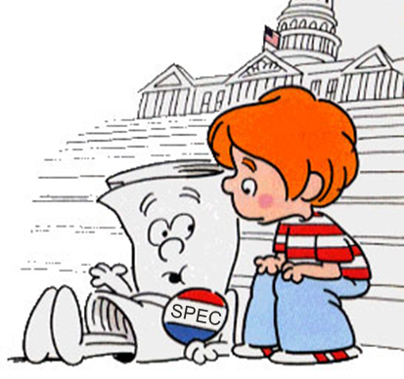
“I’m Just a Spec, Yes Only a Spec”
First Published Working Draft
Last Call
Candidate Recommendation
Working Draft
Recommendation
Canvas
Fonts
Forms
Markup
Messaging
Microdata
Transforms
Transitions
Web Sockets
Web Storage
Server-Sent Events
SVG 1.1 (2nd Ed)
Web Workers
WOFF
Geolocation
Media Queries
WAI-ARIA
MathML
SVG 1.1
Selectors (L3)
Notes:
Because HTML5 consists of over 100 specifications, you should be aware that the “readiness of HTML5” is not something that can be pinned down or answered with a single yes or no question. [Click]
Every specification under the HTML5 umbrella follows the same five-stage process from inception to recommendation, but each spec moves independently throughout that process.
As you can see some items under the umbrella are in candidate or recommendation state. Others are in last call and nearing completion. Many, as you’ll notice are at the Working Draft stage, even as several of these, like Canvas, CSS Transforms and Web Storage are being widely adopted by the major browsers.
They takeaway for you is this:
HTML5 is a term that represents a lot of what’s new and what’s next on the web, but it itself is not “one thing.” It’s not even a bunch of things that are all “site ready” today, or things that most browsers even support.
There is no such thing as “adopting HTML5” or “upgrading your site to HTML5.” Instead, as a web developer, there are technologies within the HTML5 set of specifications that you will or will not choose to adopt. Some are ready for you today, and you should use them. Others still need time, but you should be aware of them and follow them through the specification process.
Image from http://www.sableverity.com/wp-content/uploads/2009/12/Im-just-a-bill.jpg (Used with permission – License: Creative Commons Attribution)

Slide 11
The Five Most Important Words about HTML5*
* “Validation” isn’t one of them.
Notes:
So at this point, you might be feeling a bit overwhelmed. HTML5 is HUGE! How can you possibly learn it all?
At this point, I want to equip you with a few things: First, a set of five words that, I believe, represent the breadth of what matters about HTML5.
Once we have these, I’m going to shift to talking about those technologies under the HTML5 umbrella that are “site ready” for you to use today.
Then, I’ll talk about how you can stay abreast on which specifications are coming in the next version of our browser, as well as what the future might hold.

Slide 12
#1 – Hyperbole*
*It’s the best thing ever!
Notes:
The first word is Hyperbole.
You knew that HTML5 was a big deal, right? But did you know how big of a deal?
It seems like HTML5 is everywhere these days.

Slide 13
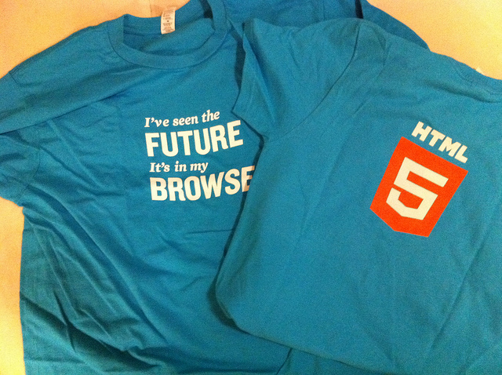
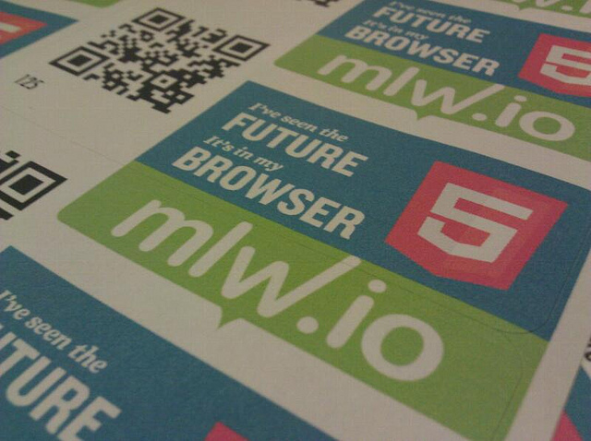
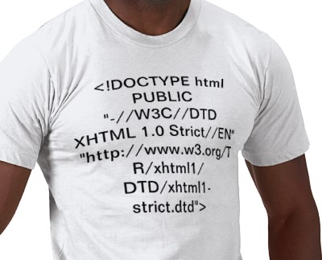
Next Up, an Album of Tony Bennett Covers…
Notes:
HTML5 is big. So big, that is has its own logo, stickers and T-Shirts.
I never remember that much hype around xhtml. I sure never had a XHTML1.1 t-shirt. Did you? [Click]
But it’s very hipster to have an xhtml shirt these days.
Images from:
T-shirt from: http://www.flickr.com/photos/igb/5409072809/ (User igb)
Stickers from: http://www.flickr.com/photos/cvander/5569384441/ (User cvander)
Fake XHTML t-shirt design: http://bit.ly/gfrKyl - Image is Mine
(All used with Permission – License: Creative Commons Attribution)

Slide 14


“Don’t Believe the Hype…”
“Taffeta phrases, silken phrases precise, three-piled hyperbole, spruce affectation, figures pedantical — these summer flies _{have} blown me full of maggot ostentation. _{I do forswear them.”}
– William Shakespeare
Notes:
The truth is, as with many things in life, HTML5 is surrounded by a lot of hyperbole, exaggeration and even misinformation.
Look, I think we all know it’s not going to “fix” the web, and it’s not going to solve all of your problems as a developer.
And you’d be wise to treat all of the platitudes and posturing around HTML5 with a grain of salt. In the immortal words of the playwright Shakespeare as paraphrased by the great 20th Century poet Flavor Flav, “Don’t believe the hype…”
Image from http://www.flickr.com/photos/tonynetone/2688212829/ (Used with permission – tonynetone – License: Creative Commons Attribution)

Slide 15
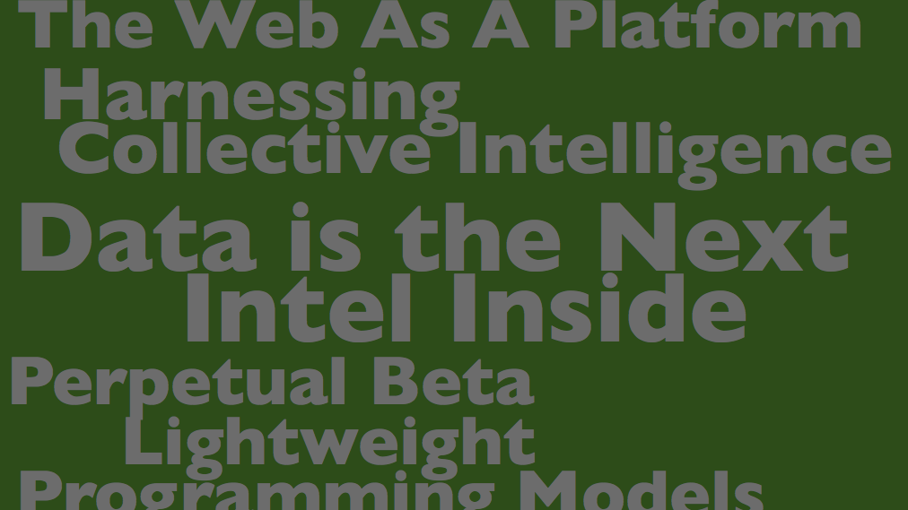
Do believe that HTML5 is changing everything.
“The future of the web is HTML5.” – Dean Hachamovitch, Microsoft
“We’re betting big on HTML5.” – Vic Gundotra, Google
“The world is moving to HTML5.”
– Steve Jobs, Apple
Notes:
…but do believe that HTML5 is important. Hyperbole or not, HTML5 is big.
In many ways, it is the final realization of much of the hype around Web 2.0. It does solve some inherit problems we have been “dealing” with, like the offline web.
It is the biggest thing to happen to the web in 20 years, so it is worth your time and attention.
As a web developer we have a bit of a balancing act here. We need to sift through the hype while embracing the scope of what’s changing now and over the next 3-5 years.
Image from http://www.flickr.com/photos/psd/3641609001/ (used with permission from psd – License: Creative Commons Attribution)

Slide 16
#2 - Compatibility*
*Your GeoCities sites are safe.
Notes:
The next word is compatibility.

Slide 17

The Web is the Largest Legacy Software System in the History of the Universe
Notes:
The Web is the largest legacy software system in the history of the universe.
And this may sound a bit hyperbolic, but it’s not.
The web has over 50 years of history. That’s fifty years of servers and software that power the sites we depend on every day. Some of the most popular sites are nearly a decade old. Others even older. Heck, I have code out there running over 10 years old, which makes me cringe.
Nearly everything that’s ever been created for the web still resides somewhere, waiting for someone to visit with a browser. Even your dad’s geocities site. Regardless of the bells and whistles of new specs and new browsers, those of old should not be left behind. As such, HTML5 was build with compatibility in mind. We’re moving the web forward, but not at the cost of breaking everything that defined us.
Compatibility also means that browsers need to play nice, and that we need to move past the browser wars of the past and STOP differentiating on features or APIs in HTML and JavaScript. Instead standardize on what happens “within the lens” that is your browser and let browser vendors differentiate on browser features like security and performance and user experience.
With HTML5, the W3C has finally arrived at a mature process whereby ALL of the major browser vendors have agreed to play nice. You, I and all of our customers benefit as a result.
Image from http://www.flickr.com/photos/paalia/2806711443/ (Used with permission from user paalia – License: Creative Commons Attribution)

Slide 18
#3 - Semantics*
*Tags have meaning.
Notes:
Semantics is an important word on the web as it relates to markup.
Semantic simply means “meaning”.
Semantic markup is html that clearly conveys to the browser and developers it’s meaning, or purpose for being on the page.

Slide 19
Neutral vs. Rich Semantics
<div>
<div id=“header”>
<header>
Notes:
In the context of semantics, you’ll often hear the terms semantically neutral or semantically rich thrown around.
The <div> [Click] is a semantically neutral element, and is a perfect example of why we need deeper meaning in HTML. By itself, it conveys no meaning to the document, to a browser or to a developer. Assigning Ids to these divs [Click], as is the current practice, is better, and conveys more meaning to developers, but it useless to browsers as they are not allowed to infer any meaning from the IDs of elements.
HTML5 introduces elements like <header> [Click], which conveys clear meaning of the intent of the element (eg. it is semantically rich). A great deal of time was spent in delivering a richer set of semantic markup in HTML5, and header is just one example.
We came at these elements through scourint the web….

Slide 20
#4 – JavaScript*
*It’s not your father’s scripting language. Well, ok... actually it is.
Notes:
Next up, JavaScript, which I’m counting as one word because there’s no space.
If you’re anything like me, and you did web development in the late 90s and early 00s, you probably considered JavaScript a bit of a toy language or just an utter pain.
If you’re also like me, you probably also re-discovered JavaScript through a framework like jQuery. And if that’s the case, some might say, you’re not really writing JavaScript, you’re writing jQuery.
But If you’re serious about HTML5, you won’t get far without digging back into JavaScript. The HTML5 spec is rife with tons of new JavaScript APIs that you will *have to learn* to properly implement these technologies such as Geolocation, Canvas or Storage to name a few.
If JavaScript wasn’t back to being a first-class language for you yet, it should be now.

Slide 21
JavaScript and the Growth of the Client
JavaScript
1990’s
Client
Server
Database
JavaScript
2000’s
Client
Server
Database
JavaScript
Today
Client
Server
Database
Notes:
In fact, just looking at how the relationship between the client, server and database has evolved, and how the expansion of JavaScript correlates with those changes should be enough to convince you that JavaScript is a serious language.
In the late 90s, JavaScript was more of a nuisance that anything else for most developers. Not only that, but it wasn’t even supported or enabled in all browsers.
Ajax changed all of that, and by the time 2005 rolled around and the term Ajax was officially coined, JavaScript had contributed to providing another level of richness on the Web. The client “grew” as more work was deferred to JavaScript on the client. This growth has only continued over the last six years, and HTML5 is proof that JavaScript is a key cornerstone of the web.

Slide 22
#5 – Polyfills*
*It’s like shims in JavaScript…for hipsters.
Notes:
According to Paul Irish, a polyfill is “…a shim that mimics a future API, providing fallback functionality to older browsers.”
Polyfills are like spackle for your web sites. You can use them to fill in the gaps in older browsers which might not support a particular feature you want to use in your site.
If you’re skeptical about using HTML5 today because of a lack of support in older browsers, you shouldn’t be. We, as resourceful web developers have created a number of best-practices allowing us to build apps with these features now.
Since we typically do not have the luxury in choose what browsers our users use, learning how to leverage polyfilling is essential to leveraging new technologies without leaving users of older browsers behind.

Slide 23
Ex. Polyfills with Modernizr
article { -moz-border-radius:10px; -webkit-border-radius:10px; border-radius:10px; }
$(function() {
if (!Modernizr.borderradius) {
// Use a jQuery plugin to round those corners
$.getScript("js/jquery.corner.js", function () {
$("article").corner();
});
}
});
“Polyfill” support with a jQuery plugin
Not supported in older browsers!
Notes:
Probably the most popular library associated with polyfills is Modernizr (www.modernizr.com), a JavaScript library that adds classes to the DOM which allows you to target specific browser functionality and provide fallback solutions for older browsers.
One example where this could be useful is Geolocation. If you wanted to use Geolocation in your site, you can use Modernizr to detect if Geolocation is supported in the user’s browser (you could also do this yourself, btw) and if it is, you can offer to find them automatically. If not, you can fall back to a form that allows them to manually enter their address.
Modernizr can also be used to “plug the gaps” and offer functionality to all users. In the example above, I’m using CSS3 to round the corners of each <article> element on my page. Older browsers don’t support this feature, but I can still provide it if I want to by checking Modernizr for the border radius property and using a jQuery plugin that provides that feature for me.
It would probably be useful to mention here that Polyfilling isn’t always required when adopting an HTML5 technology. In some cases, adoption will give users with modern browsers an enhanced experience, but won’t break an older browser’s experience. Many of the new CSS modules are great examples of, including border-radius. So it is possible to adopt a new feature and pay no attention to older browsers. They key is that you need to be aware of how a new feature will affect older browsers.

Slide 24
HTML5: Mix Tape Edition*
* Things you should use, things you should polyfill and
things you should experiment with and prototype.
Notes:
Now we’re going to drill down into some HTML5 technologies, and I’m going to show you a few demos of some of what’s new and is coming in HTML5.
With each technology I talk about, I want to be sure to answer the question: “Can I use this today?” So I’m going to spend the bulk of my time today on those things that you can and should start using in your applications now. I’ll demonstrate both how to target these new features, and how to support users with browsers where these features don’t exist.
After covering a handful of notable areas of the spec, I’ll speed through a couple of other areas that you should also be paying attention to. Some of these are new and unproven, while others are ready for primetime, but they’re all generating a lot of buzz on the web.
And while I don’t have near enough time to talk about everything, hopefully this will be a good cross-section of what’s in “the spec.”

Slide 25
Adopt (and Polyfill)*
*Mature, Site-Ready HTML5
Notes:
First off, let’s talk about those things you can and should adopt today for your applications.
These are the things we are referring to as “Site-Ready HTML5,” which means they have the broadest support across all modern browsers and you can rely on them being available to a large segment of your users.
I’ll also discuss how you can polyfill support for older browsers.

Slide 26
Semantic Markup*
*Alas, poor <div>, I hardly knew ye.
Notes:
You’ll recall that semantics was one of our five words, because it’s important to understand why HTML5 introduces changes to the HTML5 markup specification, both by eliminating unneeded cruft and adding more semantically-rich elements.

Slide 27
A Sample XHTML Document
<!DOCTYPE html PUBLIC "-//W3C//DTD XHTML 1.0 Strict//EN" "http://www.w3.org/TR/xhtml1/DTD/xhtml1-strict.dtd">
<html>
<head>
<meta http-equiv="content-type" content="text/html;
charset=utf-8">
</head>
<body>
<p> XHTML :/ </p>
</body>
</html>
Notes:
Let’s talk about unneeded cruft, first. You’ve seen this, no doubt.
This is the smallest XHTML document that I could create, and it still barely fits in this slide. HTML5 changes this drastically, and you can use those changes today in any browser, even older ones. You pages will still render.

Slide 28
A Sample HTML5 Document
<!DOCTYPE html>
<html>
<head>
<meta charset="utf-8">
<title> Hello </title>
</head>
<body>
<p> HTML5! </p>
</body>
</html>
Notes:
This is all you need to create a valid HTML5 document.
The Doctype and meta http-equiv tags been changed. It’s nice to get that cruft out of the way.

Slide 29
28 New Elements
article | footer | rt
aside | header | ruby
audio | hgroup | section
canvas | keygen | source
command | mark | summary
datalist | meter | time
embed | output | wbr
figcaption | progress
figure | rp
article | footer | rt
aside | header | ruby
audio | hgroup | section
canvas | keygen | source
command | mark | summary
datalist | meter | time
embed | output | wbr
figcaption | progress
figure | rp
Notes:
So we’re gotten some cruft out of our markup. We’ve also added 28 new elements.
Here’s a list of all of the new markup elements defined in HTML5.
I’m not going to cover most of these today, though I will briefly cover the highlighted items. There is tons of information about them available online and in great books like “HTML5 Up and Running” and “Introducing HTML5.” Remember that word “semantic?” The beautiful thing about this list is that most of these probably mean exactly what you think they mean. Except for the ruby tag.
Talk about how these tags were derived too. They represent the most used ID’s scoured across the WWW.

Slide 30
Semantic Markup
demo
Notes:
Let’s take a look at some of these new elements now.

Slide 31
Canvas and SVG*
*Your old Nintendo games, reborn! (Plus DOOM)
Notes:
Now let’s look at Canvas and SVG, two graphics technologies for the web.

Slide 32
<canvas> + JavaScript = Crazy Delicious
var canvasContext = document.getElementById("canvas")
.getContext("2d");
canvasContext.fillRect(250, 25, 150, 100);
canvasContext.beginPath();
canvasContext.arc(450, 110, 100,
Math.PI * 1/2, Math.PI * 3/2);
canvasContext.lineWidth = 15;
canvasContext.lineCap = 'round';
canvasContext.strokeStyle =
'rgba(255, 127, 0, 0.5)';
canvasContext.stroke();
Notes:
You can think of the canvas element, just like it sounds: a blank drawing surface embedded in your page. Adding <canvas> is as simple as adding the canvas tag, but you manipulate the canvas from JavaScript, where you can add shapes, text, images, gradients, transformations, effects and even animation. The canvas element is a pixel-based drawing surface.
Remember how I said JavaScript was important? Without it, all you can do with Canvas is put an element on the page. You need JavaScript to manipulate it. In this slide, we’re selecting the 2d context of the canvas, adding a rectangle, then adding a orange arc with rounded corners to the canvas.
In many ways, the Canvas is a scriptable Image tag, which is a powerful concept.
[Image captured from my computer]

Slide 33

<svg> + <html> = Stylable, Scriptable SVG
<svg xmlns="http://www.w3.org/2000/svg" viewBox="0 0 220.5 199.5">
<title>HTML5 CSS Styling Logo</title>
<path d="M32.8,0L25.4,37.0 176.0,37.0 171.3,60.9 20.6,60.9 13.3,97.9 163.9,97.9 155.5,140.1 94.8,160.2 42.2,140.1 45.8,121.8 8.8,121.8 0,166.2 87.0,199.5 187.3,166.2 200.6,99.4 203.3,86.0 220.4,0z"/>
</svg>
<style>
svg path {
fill: navy;
}
</style>
Notes:
SVG is an older graphics specification, but a powerful one. SVG, or Scalable Vector Graphics, is actually a family of specifications around providing an XML-based file-format for two-dimensional vector graphics.
SVG can be represented as a standalone .svg file or embedded as xml into your markup. Inline SVG gives you a powerful way to work with vector graphics on you page, and because it’s markup and not a binary image, you can manipulate and style anything in the SVG element and you can use script to interact with the element, much like you do with canvas.
[Image captured from my computer]

Slide 34
<canvas> and <svg>
demo
Notes:
Let’s take a look at canvas and svg in action.

Slide 35
Audio and Video*
*Media without Plugins, but lots of Codecs
Notes:
Next, we’ll look at two related elements that standardize how rich media is presented to users through the browser.

Slide 36

Media on Your Page… No Plugins Required.
<video id=“video" controls autoplay>
<source src="video.mp4" type="video/mp4“ />
</video>
document.getElementById("video").play();
<audio id="audio" src="sound.mp3" controls></audio> document.getElementById("audio").muted = false;
Notes:
Audio and Video are some of the most talked about new elements and, on face, they are very easy to use.
Practically though, Codecs complicate both audio and video because even though all browsers implement these new tags, not all agree on the proper Codecs to support.
So using audio and video today is possible, but you should, as a best practice, provide at least 3 sources of video(WebM, MP4 and Ogg Vorbis) and 2 of Audio (mp3, Ogg Theora) and fallback to Silverlight or Flash for browsers that don’t support Video and Audio tags.
[Image captured from my computer]

Slide 37
<video>
demo
Notes:
Let’s take a look at using audio and video, and at how to provide fallback.

Slide 38
Geolocation*
*Now you can try Geocaching with your ten pound laptop.
Notes:
Though not “technically” part of the HTML5 specification, it’s hard not to bring Geolocation to the party because it’s another example of the richness and interactivity coming to web applications.

Slide 39
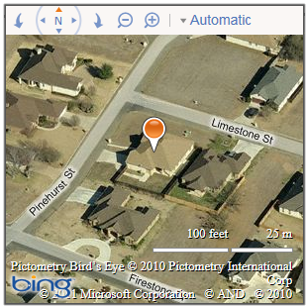
You are (within a Few Hundred Meters of) Here
//Get my location, and put it on a map
navigator.geolocation.getCurrentPosition(function(position) {
var location = new Microsoft.Maps.Location(
position.coords.latitude,
position.coords.longitude);
_map.setView({ zoom: 18, center: location });
var pin = new Microsoft.Maps.Pushpin(location);
_map.entities.push(pin);
}, errorHandler);
Notes:
If you have a smartphone, you’ve no doubt used Geolocation provided to apps by your device.
With Geolocation support in all major browsers, desktop and mobile web applications can support Geolocation as well. Here, we’re retrieving the user’s current location and using the result to populate a map.
[Images captured from my computer]

Slide 40
Geolocation
demo
Notes:
Now let’s quickly add Geolocation (with fallback and graceful degradation) to our site.

Slide 41
Storage*
*Watch those cookies crumble…
Notes:
Next up, storage. Who still fights with cookies on their sites?
HTML5 introduces a new key/value storage mechanism often referred to cookies on steroids.
They’re not cookies, though, because you have more space for local storage (up to 5mb), and the storage items are not transferred back to the server on each request, as cookies are, so using them wont slow down your site.

Slide 42
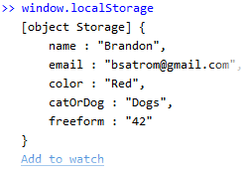
Working with localStorage
$('#save').click(function () {
window.localStorage.setItem('name',$('#name').val());
window.localStorage.email = $('#email').val();
});
$('#name').val(window.localStorage.getItem('name'));
$('#email').val(window.localStorage.email);
Notes:
Local storage is targeted at providing you the developer with a way to capture and store user-specific data in the users browser, without transmitting that information back to the server. These things are scoped only to a domain, and live beyond the browser session, meaning you can pull and use them long after the user leaves the site.
Note, as in the example here, that you can access localStorage both via getItem and setItem functions, or access the value directly using the key.
Local storage is supported in all major browsers, and has support in IE in versions 8 AND 9. What’s more, if you want to adopt Storage more broadly, there are polyfilling options that enable you to use localStorage all the way back to IE5.
[Image captured from my computer]

Slide 43
Local Storage
demo
Notes:
Let’s take a look at leveraging localStorage by adding the capability of saving user preferences locally in the browser, and then loading those.
[Be ready to speak to security of these items (sandboxed to site, etc.)]

Slide 44


Experiment*, Prototype, Give Feedback…
* Use IE10 PP and Html5 Labs to try out upcoming features.
Notes:
Now, let’s talk about how Microsoft approaches HTML5 Spec adoption, as well as how you can try out what’s on the bleeding edge of HTML5.

Slide 45

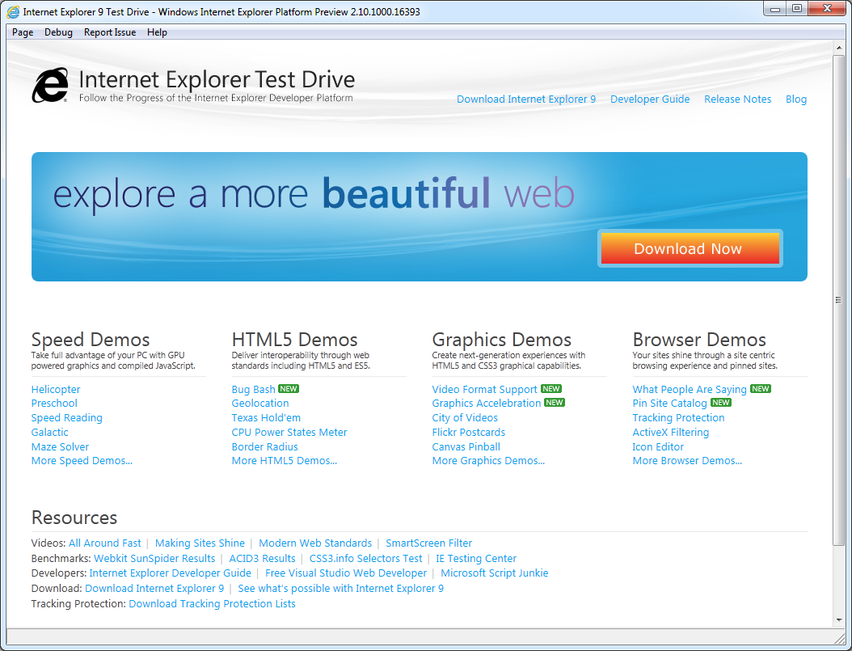
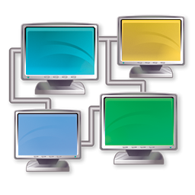
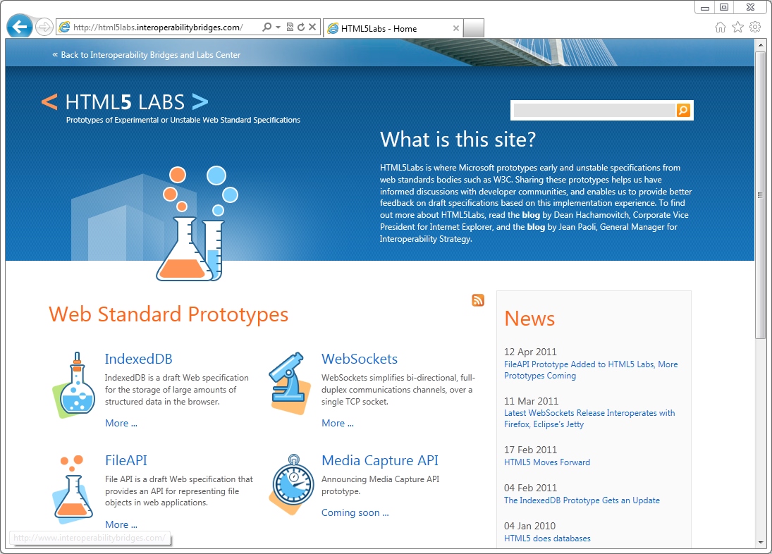
Microsoft Approach
Site Ready
HTML5
Work with
Developers
Invest on Interoperability
Innovate with Emerging Standards
Notes:
Microsoft’s Approach is fourfold:
We want to give you the best Site Ready HTML5 experience on the web via IE9. We’ve already talked a lot of IE9 today and what IE9 supports.
Beyond that, we are proactive about letting you the developer know what’s coming in the next version of our browser with the IE Platform previews.
We’re invested heavily in interoperability and have created, by far, the largest HTML5 test suite for the W3C.
And finally, we’ve created the HTML5 Labs to show how were thinking about emerging and unstable standards and how you the developer can experiment with these.
I’ll talk briefly now about the second and fourth items on this list.
[Slides provided by Internet Explorer team. Images used with permission]

Slide 46
Work with Developers
IE 10
PP1 & PP2
RTM
PP8
New in IE10:
CSS3 Flexbox
CSS3 Gradient
ECMAScript Strict
Web Workers
Forms & Validation
Drag and Drop
File API
PP7
PP6
Beta
PP4
PP3
PP2
Platform Preview 1
3.16.10
5.5.10
6.23.10
8.4.10
9.15.10
10.28.10
11.17.10
2.10.11
3.14.11
4.12.11
6.29.11
Notes:
If what we talked about with HTML5 today just wet your appetite for HTML5, you’ll want to take a look at the IE Platform Previews to see where Microsoft is going with HTML5 in the future.
On April 12, just weeks after the launch of IE9, we dropped the first Platform Preview of IE10, which included several new CSS3 and ECMAScript features.

Slide 47
IE10 PP2 & File API
demo
Notes:
Let’s take a quick look at the IE10 Platform Preview, specifically the File API features added to the second Platform Preview

Slide 48
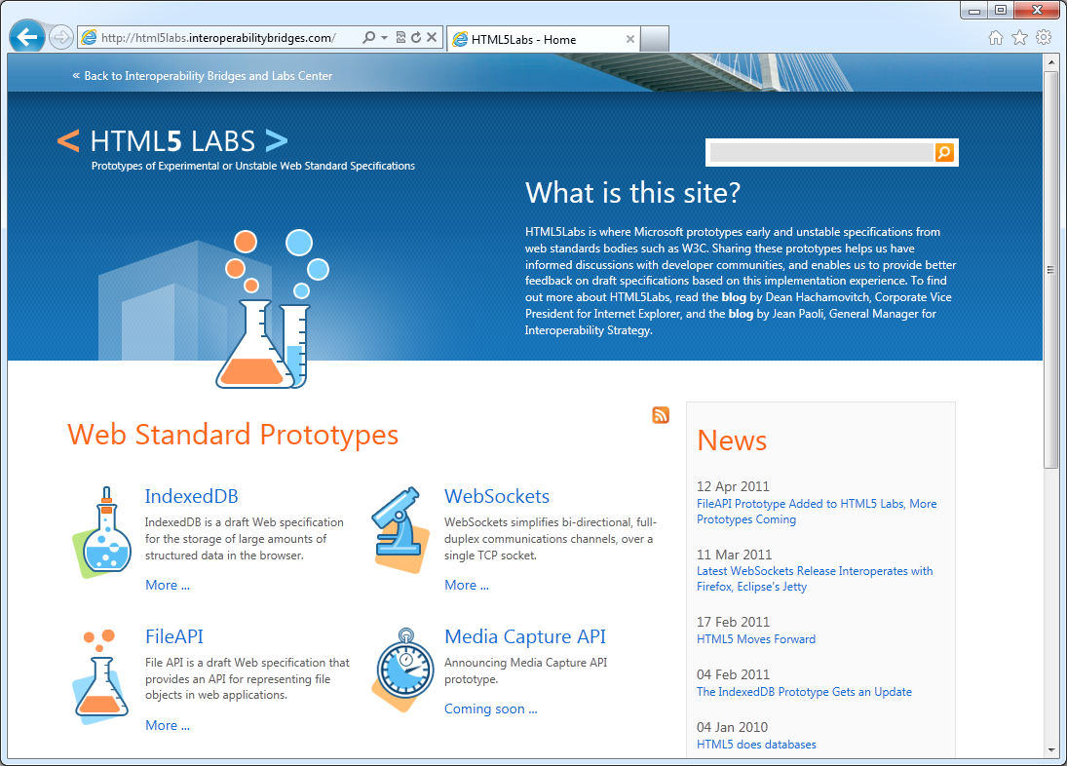
Innovate with Emerging Standards
Notes:
Beyond what we have today in IE9, and what’s coming in IE10, We want to give developers a platform to try out some experimental standards that are still being vetted by the W3C.
Html5labs.com is a place you can go to see what we’re thinking about. Let’s look at a one of those now.
[Image from my computer]

Slide 49
FileAPI – File Objects in Web Apps
var file = document.getElementById('file').files[0];
document.getElementById('name').textContent = file.fileName; document.getElementById('size').textContent = file.fileSize; var reader = new FileReader(); reader.readAsText(file);
EvilPlans.txt
Name
Size
Data
Notes:
The FileAPI is a W3C draft Web specification for representing file objects in web applications, as well as programmatically selecting them and accessing their data.
The FileAPI is currently being standardized by the W3C Web Applications Working Group. HTML5 Labs has a downloadable prototype for working with the FileAPI that you can download at html5labs.com

Slide 50
Web Sockets – Real Time Connections
var socket = new WebSocketDraft('ws://my.websocket.org/echo'); socket.onopen = function(event) { socket.send('Hello, WebSocket'); }; socket.onmessage = function(event) { alert(event.data); } socket.onclose = function(event) { alert('closed'); }
Client
HTTP
Server
TCP
Notes:
Web Sockets are a Full-duplex, bi-directional communication over the Web: Both the server and client can send data at any time, or even at the same time. Only the data itself is sent, without the overhead of HTTP headers, dramatically reducing bandwidth.
Web Sockets has been the subject of a lot of press and debate due to its early inclusion and subsequent removal from some browsers, but the technology isn’t gone. In fact, it’s being actively worked on by two standards bodies as we speak. Microsoft has published several updates to our demo Web Sockets implementation, and continues to update the demo with each publication of the specification. Try it out for yourself at HTML5Labs.com
Web sockets are accessed through the WebSocket object. Sites open a socket at an end point, send messages and respond to new messages.

Slide 51
HTML5 Labs and Web Sockets
demo
Notes:
Let’s take a quick look at HTML5 Labs, and specifically some demos around Web Sockets and the File API

Slide 52
HTML5 in Web Technologies
VS 2010 SP1 – HTML5 Schema and Intellisense
WebMatrix – HTML5 default doctype
ASP.NET MVC 3 tools update
HTML5 template for new projects
Modernizr 1.7 included in new projects
Expression Web 4 SP1 – HTML5 Schema and Intellisense
Richer CSS style editing
SuperPreview Page Interaction Mode and Online Service
Notes:
I’ve shown you three different tools in our demos today: VS 2010, Web Matrix and Expression Web 4. Each of these tools already has support for HTML5 markup and CSS3, out of the box, as you’ve seen. And I’m sure this is just the beginning of what Microsoft will offer developers related to HTML5.
One thing that I do want to mention that I didn’t show, but is related to your HTML5 development is the new SuperPreview in Expression Web 4 SP1. If you’re not familiar with SuperPreview, it’s a tool in Expression Web (and also available as a Standalone download) that enables you to view your site across multiple browsers in several modes, side-by-side, overlaid to see minor differences and in a DOM mode which shows the DOM created across multiple browsers. SuperPreview in Expression Web 4 SP1 adds even more features like the ability to test pages behind a login and to use an online service to test you site in browsers NOT currently running on your machine, so you no longer need to have several browsers installed on your machine solely for the purpose of testing.
[If question comes up] MS is committed to providing tool support for standards based web development, beyond this and into the future.

Slide 53
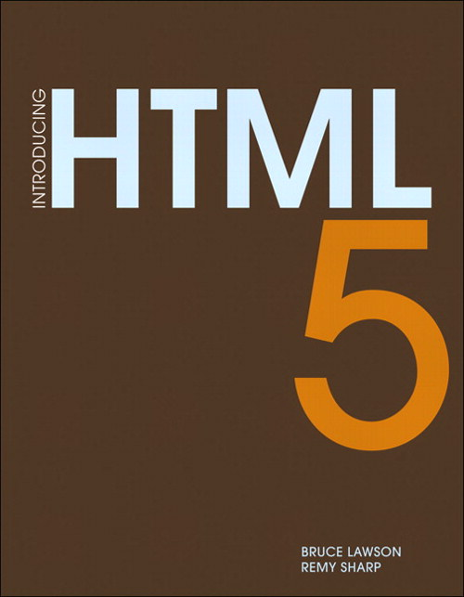

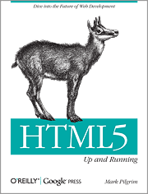
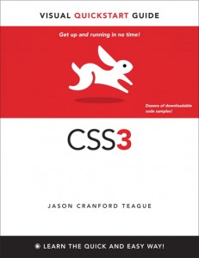


Things You Need to Learn (a.k.a. Resources)
Read two good HTML5 books
Read a good CSS3 book
Relearn JavaScript
Learn a JavaScript framework
jQuery, for instance
Learn the dev tools in your favorite browser
IE9? Just hit F12!
Notes:
Your call to action is simple: read, learn and use. Read some books on HTML5, JS and CSS, and some of the ones I love are available in the bookstore on site, so go pick them up and start reading today. Learn JS and jQuery and learn to really use the developer tools in your favorite browser. If that’s IE9, just hit F12.
Image of Introducing HTML5 from http://www.peachpit.com/store/product.aspx?isbn=0321687299
Image of HTML5 Up and Running from http://oreilly.com/catalog/9780596806033
Image of CSS3: Visual Quickstart Guide from http://www.speaking-in-styles.com/index.php/the-book/css3-visual-quickstart-guide/
Image of JavaScript: The Good Parts from http://oreilly.com/catalog/9780596517748/
Image of Eloquent JavaScript from http://oreilly.com/catalog/9781593272821/
Image of jQuery in Action from http://www.manning.com/bibeault2/
(All book cover images are public domain)

Slide 54
Go Start Using HTML5 Today!
– Semantic Markup
– Canvas
– Audio and Video
– Geolocation
– Web Storage
– CSS3
http://ieTestDrive.com
http://html5labs.com
http://WebMatrix.com
Adopt
@csell5
www.ClarkSell.info
csell@microsoft.com
Experiment
– IE10 Platform Preview
– HTML5 Labs
Slides and Demos :: http://bit.ly/ivQATJ
Notes:
As we wrap up, I want you to remember that HTML5 is a large set of shifting technologies.
Hopefully I’ve given you
A concise definition of HTML5
The ammunition to choose what you’re ready to adopt today
What you need to do to adopt new technologies while continuing to enable great experiences for older browsers
Where you can go to find out what’s on the bleeding edge
The Web today is changing faster than ever before, and that pace isn’t slowing. As a web developer, you can keep up and even stay ahead of this change by staying aware of what you can use today, and what you should keep an eye on.
Thank you for coming today, now go and build the next great Web Applications.

Slide 55

Conversation and Questions
Notes:
As we wrap up, I want you to remember that HTML5 is a large set of shifting technologies.
Hopefully I’ve given you
A concise definition of HTML5
The ammunition to choose what you’re ready to adopt today
What you need to do to adopt new technologies while continuing to enable great experiences for older browsers
Where you can go to find out what’s on the bleeding edge
The Web today is changing faster than ever before, and that pace isn’t slowing. As a web developer, you can keep up and even stay ahead of this change by staying aware of what you can use today, and what you should keep an eye on.
Thank you for coming today, now go and build the next great Web Applications.

